Slide 1

Using Tweets for Single Stock Price Prediction
-By Suman Chatterjee(Admn No.-15JE001400)
And
Meet Patel(Admn No.-15JE001161).

Slide 2
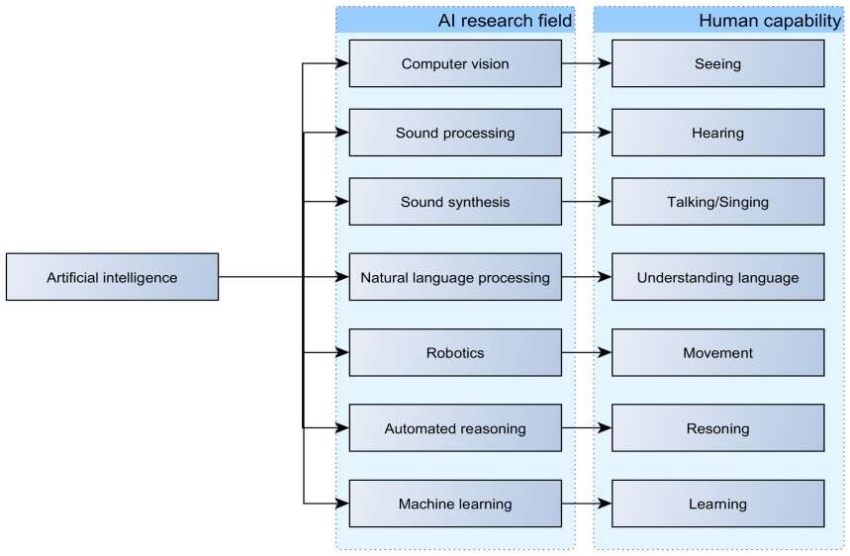
What is Machine Learning?

Slide 3
Introduction
Machine learning is the subfield of computer science that "gives computers the ability to learn without being explicitly programmed" (Arthur Samuel, 1959).
Evolved from the study of pattern recognition and computational learning theory in artificial intelligence, machine learning explores the study and construction of algorithms that can learn from and make predictions on data – such algorithms overcome following strictly static program instructions by making data-driven predictions or decisions, through building a model from sample inputs.

Slide 4
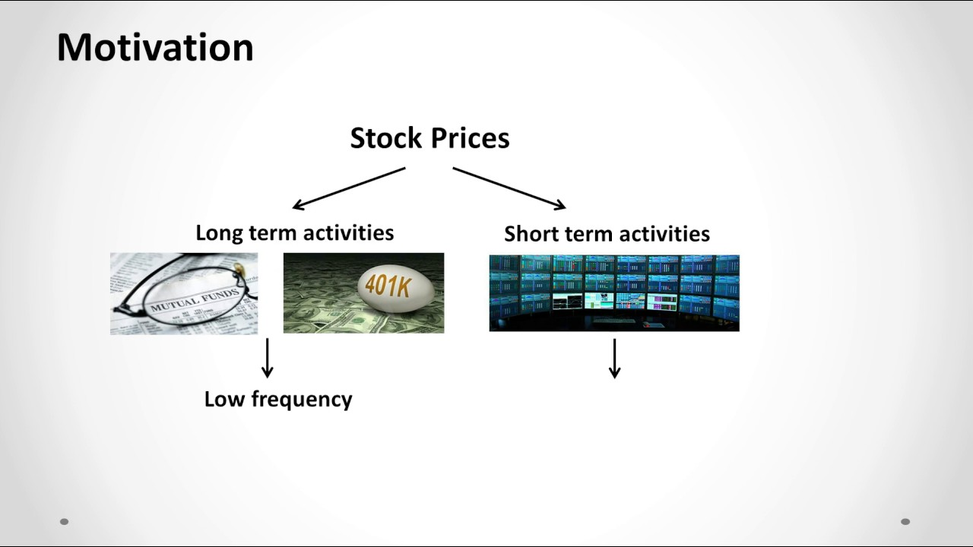
Predicting long term movement of stock price
Use machine learning on past 2-3 year data
Data obtained using Bloomberg terminal
Data include 28 indicators
Book value, Market capitalization, Change of stock Net price over the one month period, Percentage change of Net price over the one month period, Dividend yield, Earnings per share, Earnings per share growth, Sales revenue turnover, Net revenue, Net revenue growth, Sales growth, Price to earnings ratio, Price to earnings ratio -five years average, Price to book ratio, Price to sales ratio, Dividend per share, Current ratio, Quick ratio, Total debt to equity, margins, asset turnover…

Slide 5
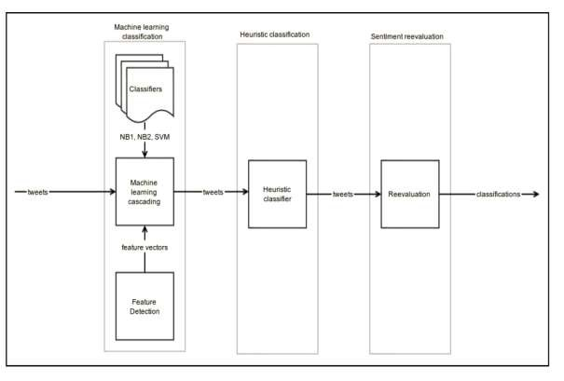
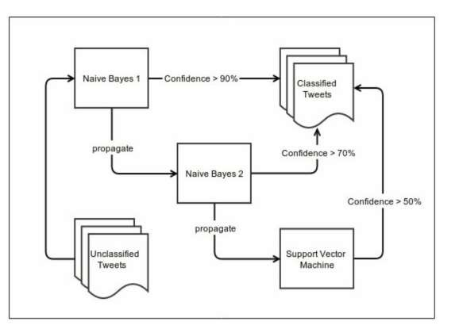
Sentiment classification

Slide 6
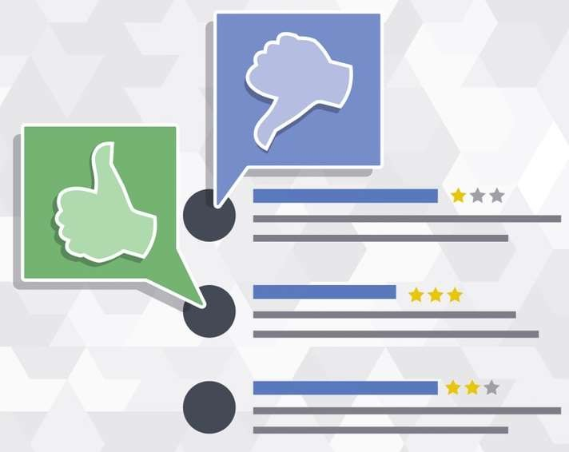
Twitter sentiment - challenges
Short text – dense information
Ungrammatical language
Abbreviations
Typos
Emoticons
Links, hashtags, mentions

Slide 7
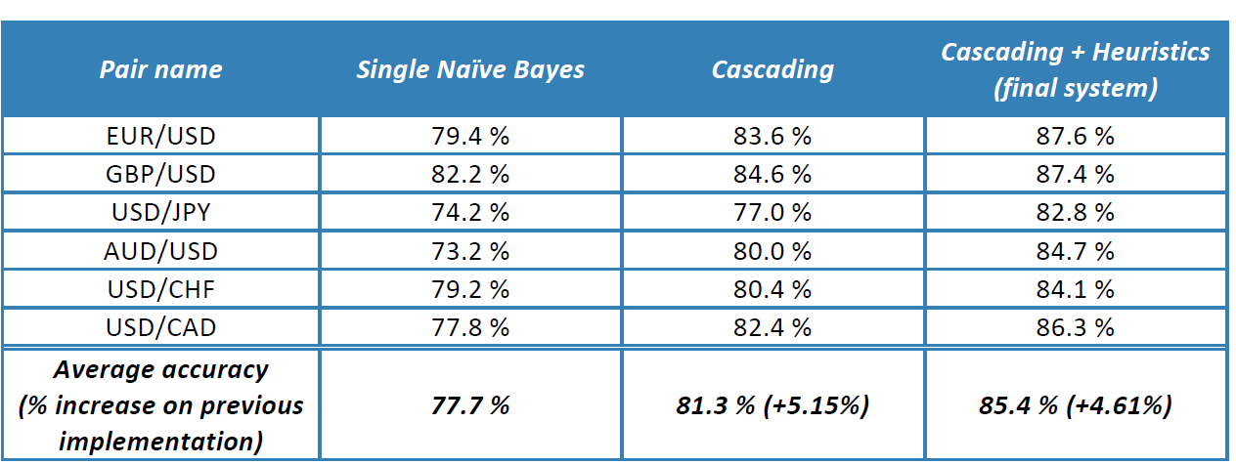
Evaluation - sentiment

Slide 8
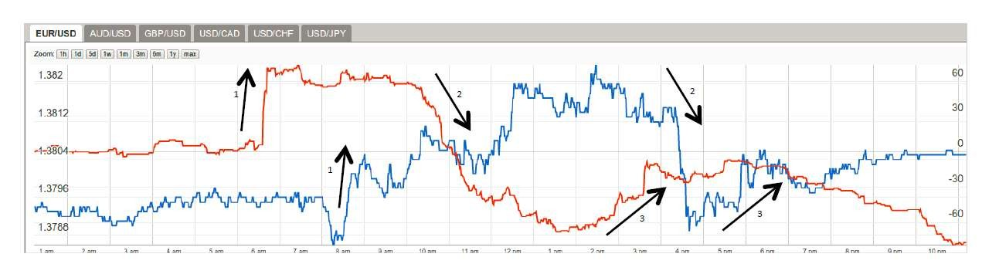
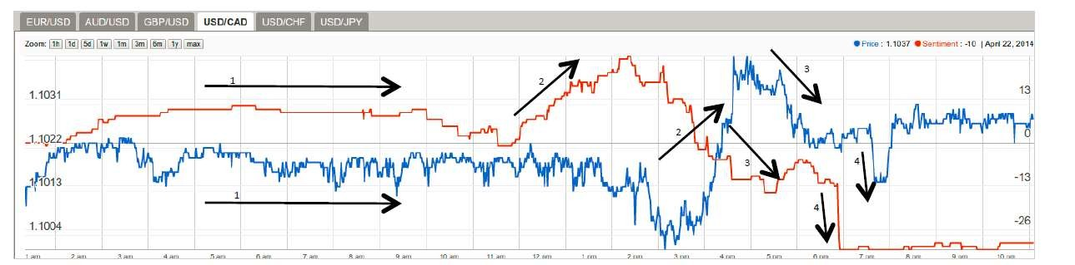
Correlations – sentiment vs pair

Slide 9
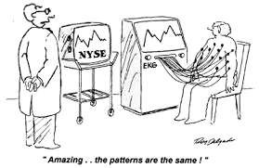
Correlations with sentiment (What we found?)
There is correlation between sentiment and market movement
In time it is variable (some times 5 minutes, some times 5 hours)
Some times ambiguous
More research necessary
When to enter/exit?

Slide 10
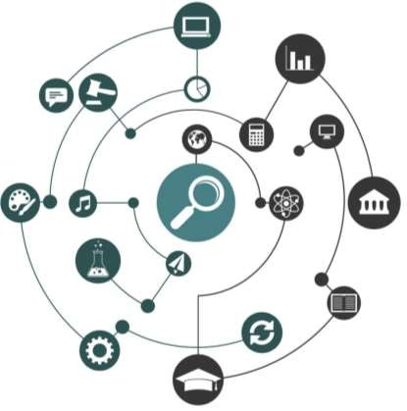
Conclusion
Finance is all about information
Information flooded world
Machine learning, data science, text mining
Here to HELP! Try them
Predicting without emotional influence
Accountability
Consider all information for better prediction
More than human can digest

